Slide 1

1.3 > DEDICATED GAS PIPELINE UPDATE > Safety Indicators
CONFIDENTIAL
September 2026 · consolidated Compressor Plant (CP) + Pipeline
TRICF Frequency
TVCR Frequency
Man-hours worked (HHT)
Kilometers driven
Total personnel (month)
0.00
0.00
62,676
346,907
409
Cum. Aug–Sep · target 2.35
Within target
Cum. Aug–Sep · target 0.79
Within target
Cum. Aug–Sep 2026
Other KPIs · September
0
DAFWC
KPI | CP + Pipeline
DAFWCF (target 0) | 0
TRICF | 0
SVCR (reporting) | 0
FAC (reporting) | 0
INV · days (≤ 20) | 0
0
TRICF
FAC
0
Road safety · TVCR
0
Observations (OCS)
462
TRICF · cases and frequency × 10^6 /HHT
TVCR · cases and frequency × 10^6 /km

Slide 2
1.3 > DEDICATED GAS PIPELINE UPDATE > Proactive Safety Actions
CONFIDENTIAL
MANAGEMENT SAFETY WALKS
SAFETY CAMPAIGNS
DRILLS · target 100%
OBSERVATIONS (OCS)
TRAINING HOURS (HHS)
TRAINING · SEPTEMBER
Training % vs HHT
2.87%
HHS / HHT · CP + Pipeline · target ≥ 1.00%

Slide 3
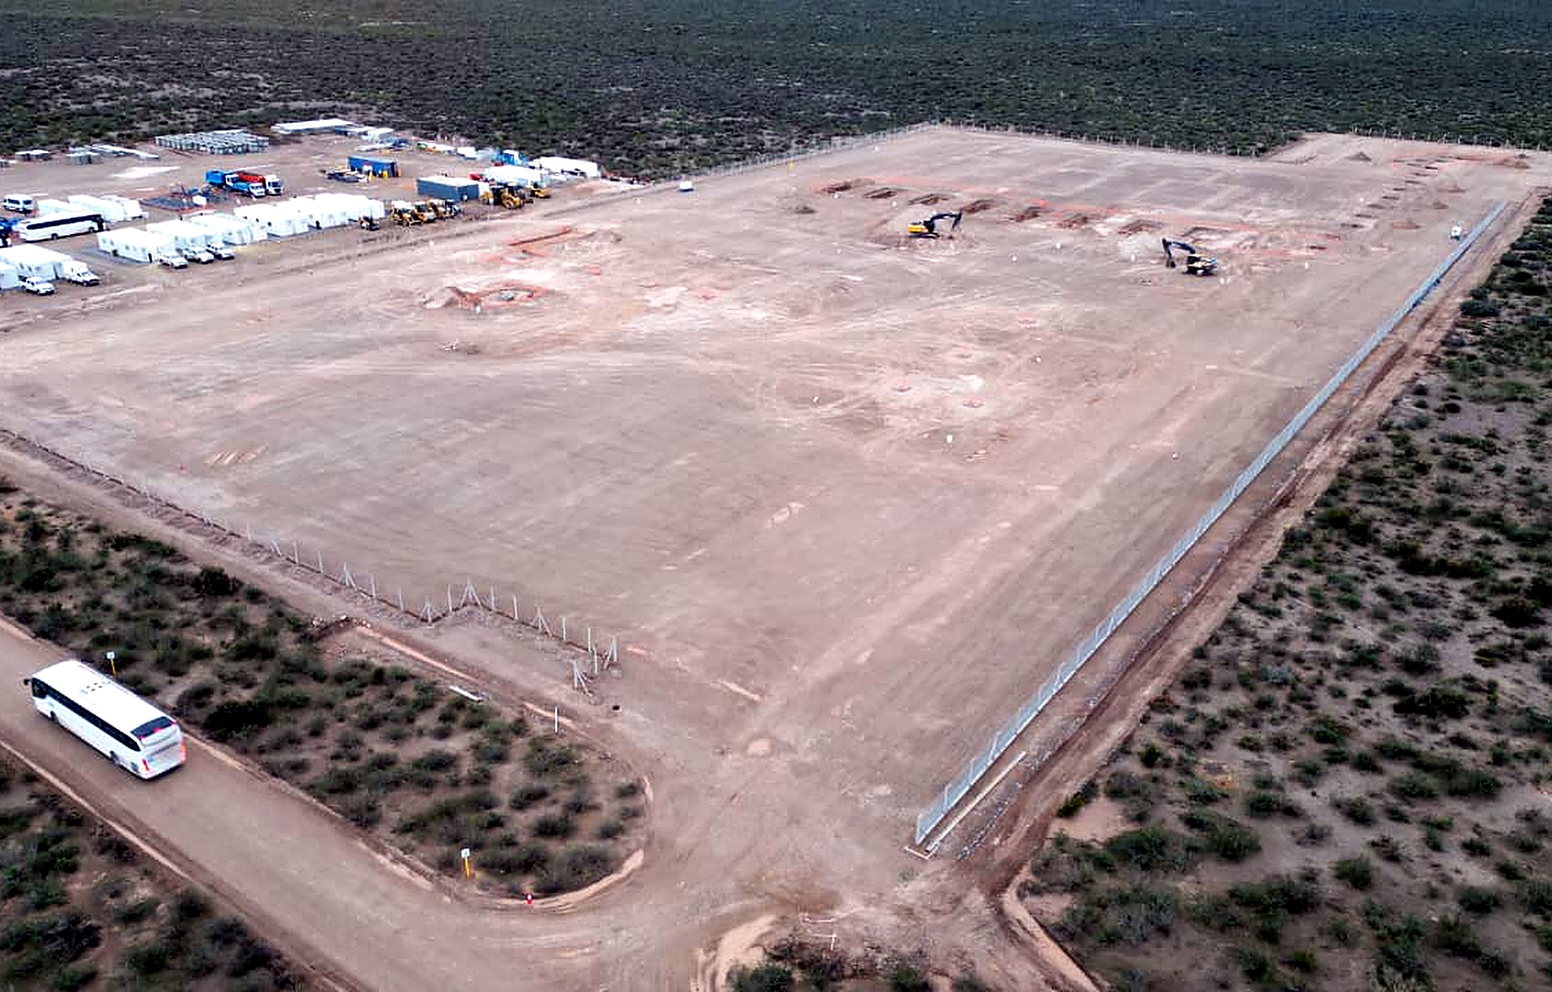
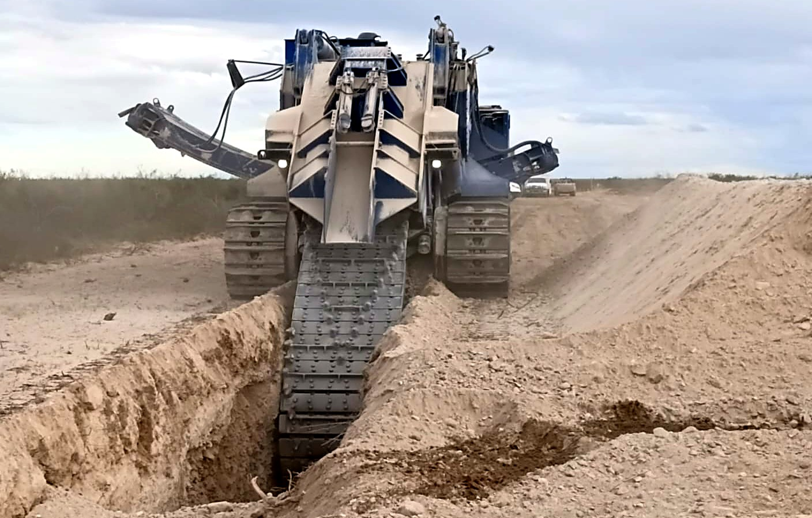
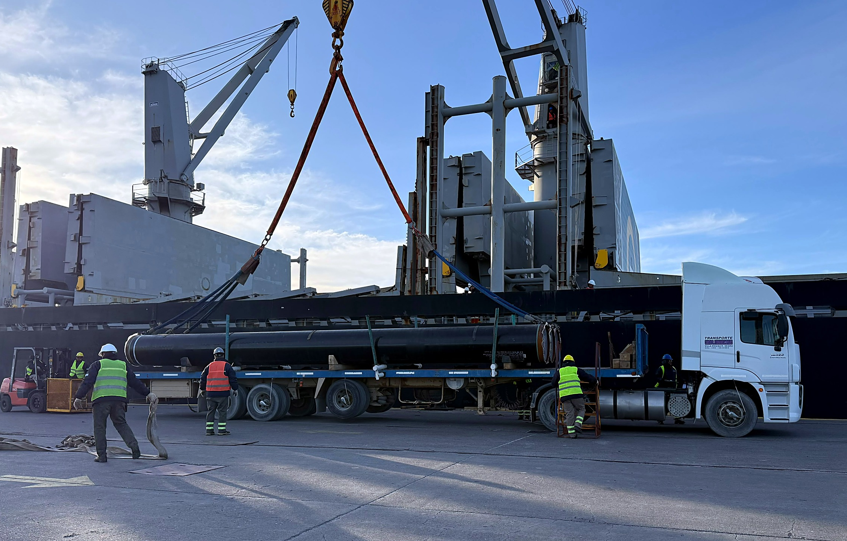
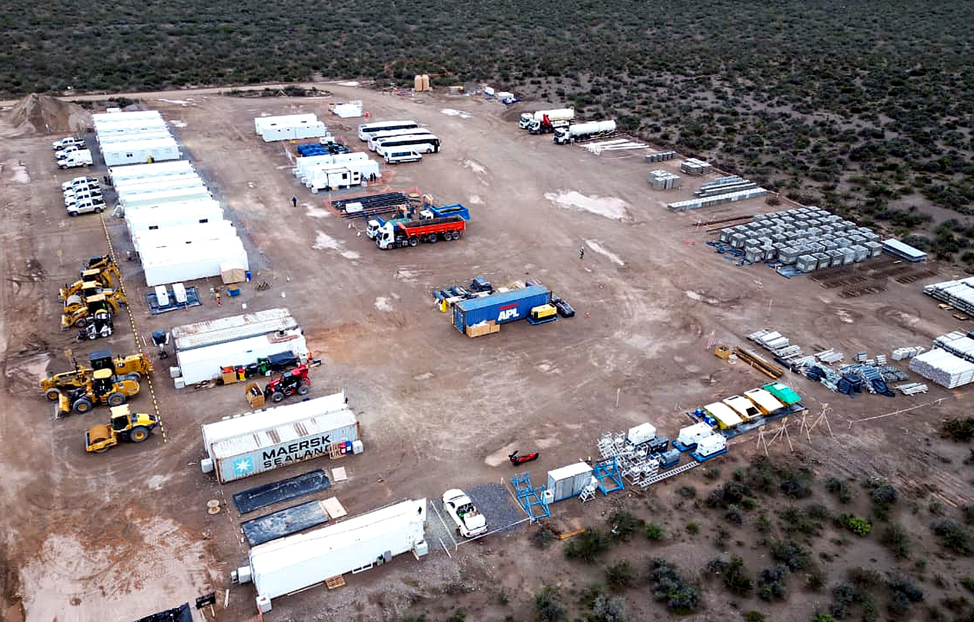
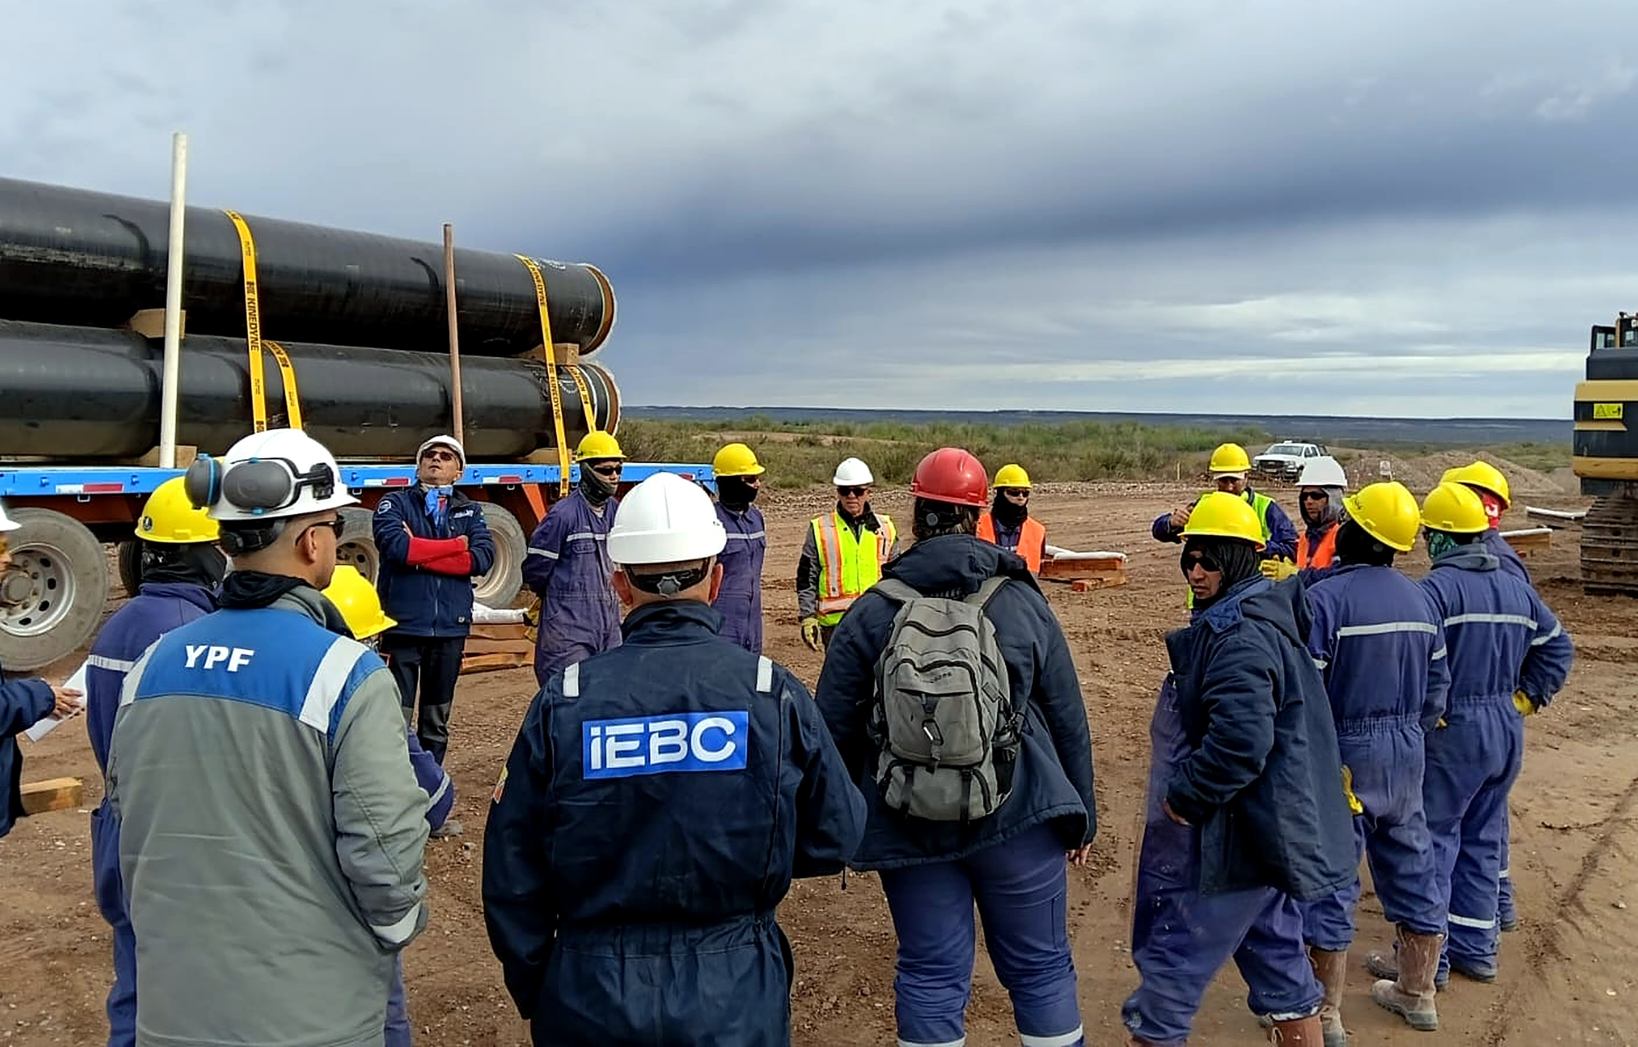
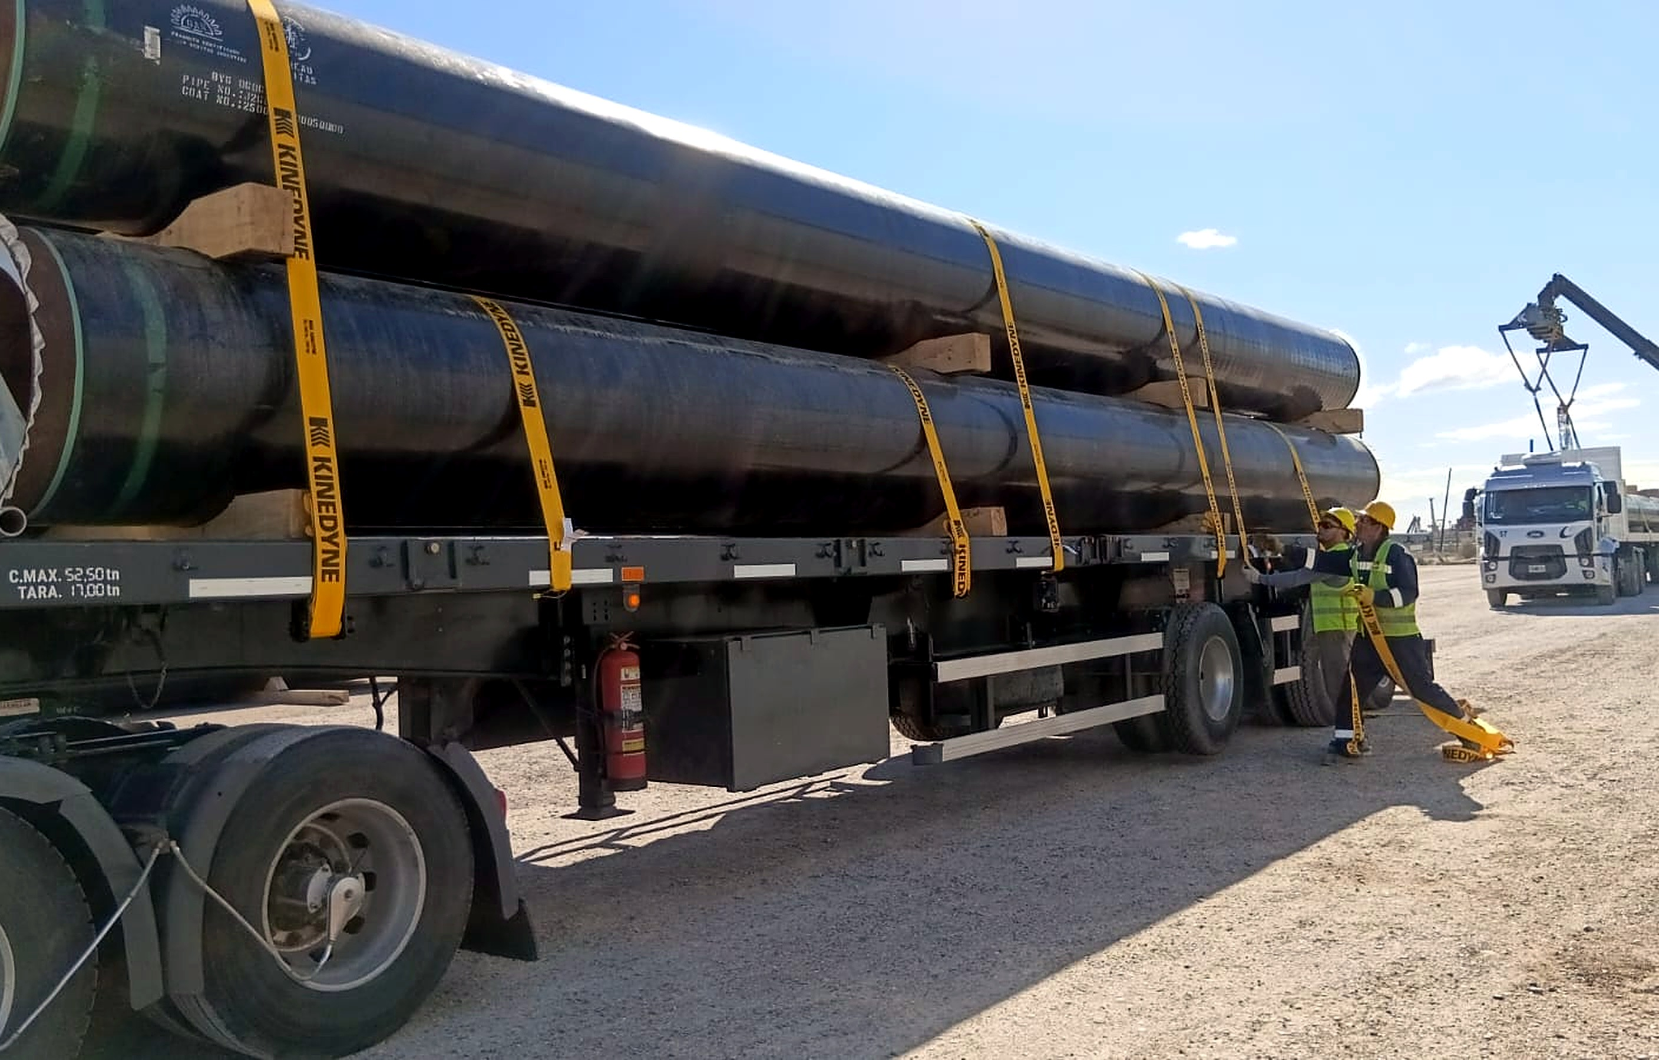
1.3 > DEDICATED GAS PIPELINE UPDATE > Updates & Photo Log
CONFIDENTIAL
September 2026 · 2 photos per area: Compressor Plant, Pipeline (right-of-way) and Pipeline · SAE Port
COMPRESSOR PLANT
PIPELINE
PIPELINE · SAE PORT
Compressor Plant site (1)
Pre-trenching works
Receiving pipe from the vessel · SAE Port
Compressor Plant site (2)
Pre-start safety talk before pipe unloading and stringing
Loading onto transport at the laydown yard · SAE Port

